Slide 1
Project task manager
High level design

Slide 2
What is a user
A User contains following information
User name
Password
User’s assignment queue

Slide 3
What can a user do?
A User contains following information
Register themselves
Create tasks
Login to their account
Take a look at their assigned tasks (login required)
Take action on their assigned tasks (login required)
mark them completed
mark them removed
unassign themselves from the task
reassign the task to another user

Slide 4
What is a task
A Task contains following information
Task id
Status
Title
Assignee
Target date
priority

Slide 5
What is a Queue
A queue is an entity that contains an arraylist of tasks along with methods to operate on the said arraylist.
Each task can be tracked by multiple queues at the same time.
Users can
Get top task – O(n)
Enqueue – O(n)
Dequeue – O(1)
Print all tasks in the queue – O(n)
Find a specific task in a specific queue or a global queue – O(n)

Slide 6
What are the different task Queues
Global Queue – to keep track of every task
In progress Queue – to keep track of all new/in progress tasks
Removed Queue – to keep track of all removed tasks
Completed Queue – to keep track of all completed tasks
User specific Queue (1 for each user) – to keep track of all new/in progress tasks assigned to the user

Slide 7
User experience notes
Users can navigate through the application via cascading menus (kind of like the IVR systems which we use on phone calls)
Users can use letters on keyboard to navigate the menus and provide inputs on the rest of the application.
The application is designed to run perpetually until the user chooses to exit by choosing the correct options

Slide 8
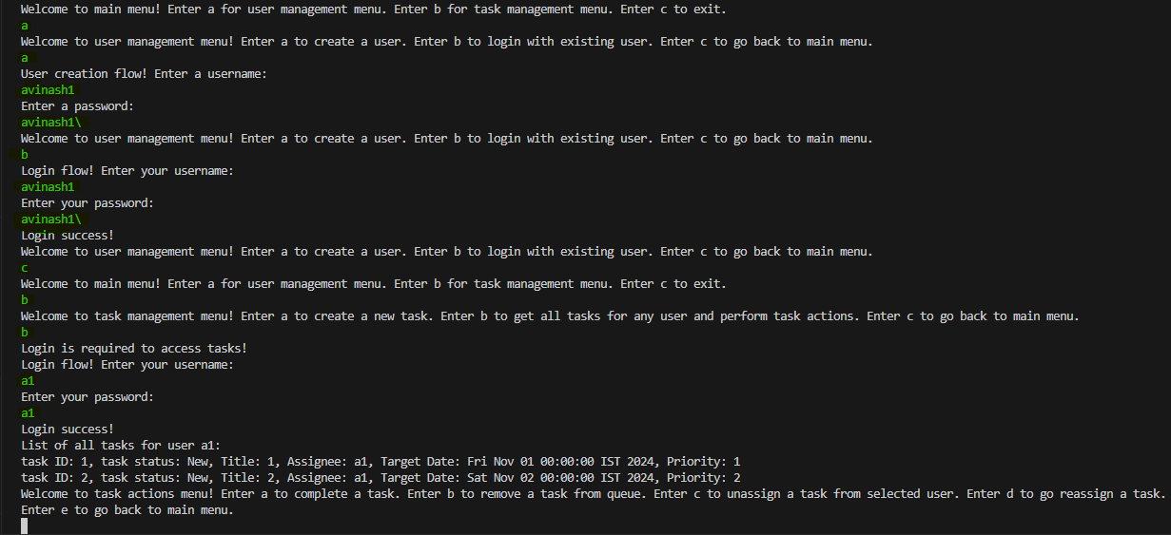
Example:
Yellow = system output

Slide 9
Key implementation notes
Usage of Arraylists for task queues.
Usage of Hashmap to store a map of all users as a searchable database.
Usage of String operations and date formatting operations for task details.
Usage of a basic self-developed hash function to skip storing actual passwords for added security.
Usage of while(true) loops and break statements to keep the app running perpetually until user decides to exit.
Handling of most of the possible exceptions in a way that the application is robust and users can keep retrying their actions without the application breaking/stopping.
No AI help was taken. Although a lot of learning happened on the fly from online non-AI resources, all of the code is handwritten.

Slide 10
Ideas for future updates
Automated/manual queue reordering based on priority/dates

